Slide 1

Rethinking NoCs for
Spatial Neural Network Accelerators
Hyoukjun Kwon, Ananda Samajdar, and Tushar Krishna
Georgia Institute of Technology
Synergy Lab (http://synergy.ece.gatech.edu)
NOCS 2017
Oct 20, 2017

Slide 2

Emergence of DNN Accelerators
Emerging DNN applications

Slide 3
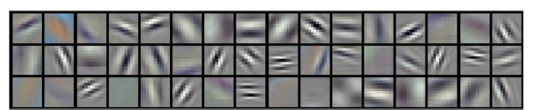
Emergence of DNN Accelerators
Convolutional Neural Network (CNN)
Convolutional Layers
(Feature Extraction)
Summarize features
Conv.
Layer
Conv.
Layer
Conv.
Layer
Pool.
Layer
FC
Layer
...
“Palace”
Intermediate features
Notes:
Features -> could be edges, etc.

Slide 4
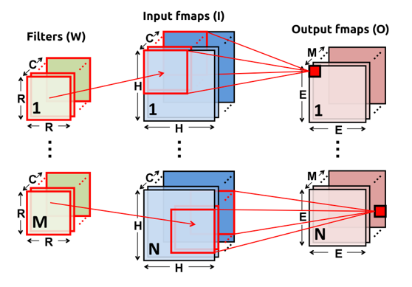
Emergence of DNN Accelerators
Computation in Convolutional Layers
Sliding window operation over input featuremaps
Image source: Y. Chen et al., Eyeriss: A Spatial Architecture for Energy-Efficient Dataflow for Convolutional Neural Networks, ISCA 2016
Notes:
Explain from images -> filters -> (convolving them) output

Slide 5
Emergence of DNN Accelerators
Massive Parallelism in Convolutional Layers
for(n=0; n<N; n++) { // Input feature maps (IFMaps)
for(m=0; m<M; m++) { // Weight Filters
for(c=0; c<C; c++) { // IFMap/Weight Channels
for(y=0; y<H; y++) { // Input feature map row
for(x=0; x<H; x++) { // Input feature map column
for(j=0; j<R; j++) { // Weight filter row
for(i=0; i<R; i++) { // Weight filter column
O[n][m][x][y] += W[m][c][i][j] * I[n][c][y][x]}}}}}}}
Accumulation
Multiplication

Slide 6
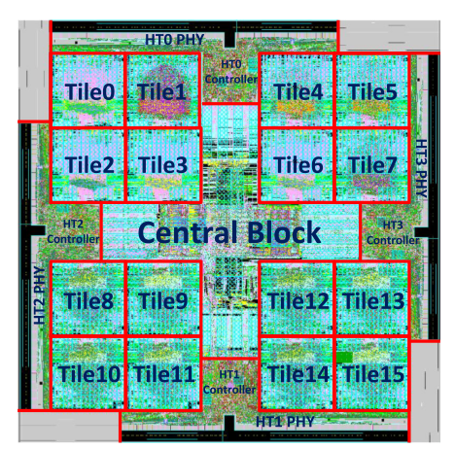
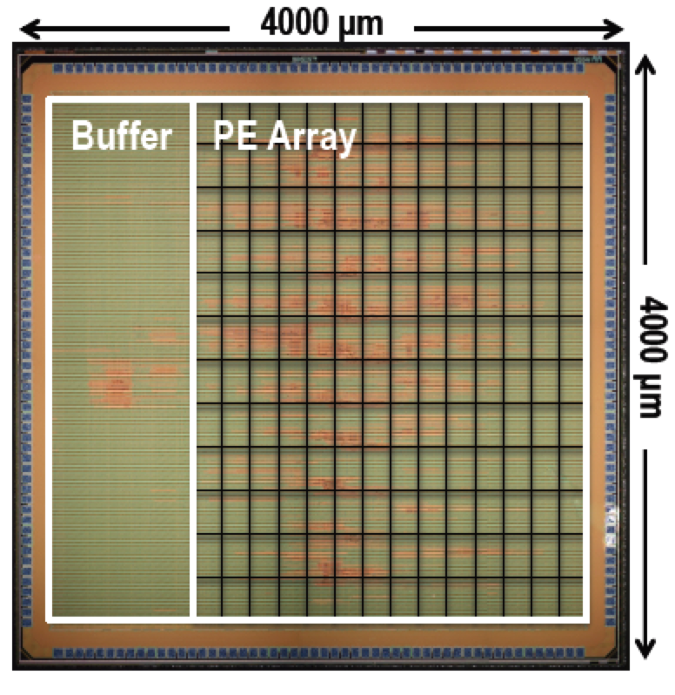
Emergence of DNN Accelerators
Spatial DNN Accelerator ASIC Architecture
Dadiannao (MICRO 2014)
Eyeriss (ISSCC 2016)
256 PEs (16 in each tile)
168 PEs
*PE: processing element
Notes:
General purpose is not as efficient as DNN accelerators (not good for exracting the paralleims)

Slide 7
Emergence of DNN Accelerators
Spatial DNN Accelerator ASIC Architecture
Global Memory
(GBM)
NoC
PE Array
PE
PE
...
PE
DRAM
PE
PE
...
PE
...
PE
PE
PE
Multi-Bus: Eyeriss
Mesh: Diannao, Dadiannao
Crossbar+Mesh: TrueNorth
Spatial processing over PEs
Notes:
Why do we need a NoC? => Support different traffic patterns dependning on the DNN that is mapped. (If we have only one to support, a special structure wiil be sufficient )

Slide 8
Challenges with Traditional NoCs
Relative Area Overhead Compared to Tiny PEs
Crossbar Switch
Eyeriss PE
Bus
Mesh
PE
Throughput
Size of squares of NoC: Total area divided by the number of PEs (256 PEs)
Notes:
Correspondingly power is also huge
Mesh/crossbar are good for CMPs that the cores are large
Let’s look at meshes and buses

Slide 9
Challenges with Traditional NoCs
Bandwidth
Alexnet Conv. layer
Simulation Results (RS)
Serialized broad-/multi-casting
Bandwidth bottleneck at top level
Bus provides low bandwidth for DNN traffic
Notes:
Details about the simulation will be explained later
Compare bus vs mesh
Latency -> Runtime
No clear winner
More PEs -> should lower latency

Slide 10
Challenges with Traditional NoCs
Dataflow Style Processing over Spatial PEs
PE
PE
...
PE
PE
PE
...
PE
PE
PE
...
PE
PE
PE
...
PE
PE
PE
PE
PE
PE
PE
Systolic Array (TPU)
Eyeriss
No way to hide the latency
Traffic is different from that of CMPs and MPSoCs

Slide 11
Challenges with Traditional NoCs
Unique Traffic Patterns
Core
Core
Core
GPU
GBM
NoC
PE
PE
PE
Core
Core
Sen
sor
Comm
PE
CMPs
MPSoCs
DNN Accelerators
Dynamic
all-to-all traffic
Static fixed traffic
?

Slide 12
Traffic Patterns in DNN Accelerators
Scatter
GBM
NoC
PE
GBM
NoC
PE
PE
PE
PE
PE
PE
PE
One-to-All
One-to-Many
E.g., filter weight and/or input feature map distribution

Slide 13
Traffic Patterns in DNN Accelerators
Gather
GBM
NoC
PE
GBM
NoC
PE
PE
PE
PE
PE
PE
PE
All-to-one
Many-to-one
E.g., partial sum gathering

Slide 14
Traffic Patterns in DNN Accelerators
Local
GBM
NoC
PE
PE
Key optimization to remove traffic between GBM and PE array and maximize data reuse in the PE array
PE
PE
Many one-to-one
e.g., psum accumulation

Slide 15
Why Not Traditional NoCs
Unique Traffic Patterns
Core
Core
Core
GPU
GBM
NoC
PE
PE
PE
Core
Core
Sen
sor
Comm
PE
CMPs
MPSoCs
DNN Accelerators
Scatter
Gather
Local
Dynamic
all-to-all traffic
Static fixed traffic

Slide 16
Requirements for NoCs in DNN Accelerators
Requirements
  High throughput: Many PEs
  Area/power efficiency: Tiny PEs
  Low latency: No latency hiding
  Reconfigurability: Diverse neural network dimensions
Optimization Opportunity
  Three traffic patterns: Specialization for each traffic

Slide 17
Outline
Motivations
Microswitch Network
  Topology
  Routing
  Microswitch
  Network Reconfiguration
  Flow control
Evaluations
  Latency (throughput)
  Area
  Power
  Energy
Conclusion

Slide 18
Topology: Microswitch Network
Top Switch
Middle Switch
Bottom Switch
Lv 0
Lv 1
Lv 2
Lv 3
Distribute communication to tiny switches
Notes:
REmove Other GBM links

Slide 19
Routing: Scatter Traffic
Tree-based broad/multicasting

Slide 20
Routing: Gather Traffic
Multiple pipelined linear network
Bandwidth bound to GBM write bandwidth
Notes:
Mention arbiter

Slide 21
Routing: Local Traffic
Linear single-cycle multi-hop (SMART*) network
H. Kwon et al., OpenSMART: Single cycle-Multi-hop NoC Generator in BSV and Chisel, ISPASS 2017
T. Krishna et al., Breaking the On-Chip Latency Barrier Using SMART, HPCA 2013

Slide 22
Microarchitecture: Microswitches
Notes:
As spatial accelerators distribute computation over tiny PEs, we distribute communication over tiny switches

Slide 23
Microswitches: Top Switch
Only required for switches connected with global buffer
Scatter Traffic
Only required if a switch has multiple gather inputs
Gather Traffic
Local Traffic
Notes:
Red boxes: Only necessary to some of the switches

Slide 24
Microswitches: Middle Switch
Only required for switches in the scatter tree
Scatter Traffic
Gather Traffic
Local Traffic
Notes:
Red boxes: Only necessary to some of the switches

Slide 25
Microswitches: Bottom Switch
Scatter Traffic
Gather Traffic
Local Traffic
Notes:
Red boxes: Only necessary to some of the switches

Slide 26
Topology: Microswitch Network
Top Switch
Middle Switch
Bottom Switch
Lv 0
Lv 1
Lv 2
Lv 3

Slide 27
Outline
Motivations
Microswitch Network
  Topology
  Routing
  Microswitch
  Network Reconfiguration
  Flow control
Evaluations
  Latency (throughput)
  Area
  Power
  Energy
Conclusion

Slide 28
Scatter Network Reconfiguration
Control Registers
En_Up
En_Down
Notes:
Firstbit: Upper

Slide 29
Scatter Network Reconfiguration
Reconfiguration logic
En_Up
En_Down
Recursively check destination PEs in upper/lower subtrees
Notes:
Firstbit: Upper

Slide 30
Scatter Netowrk Recofiguration
Reconfiguration logic

Slide 31
Local Network: Linear SMART
Dynamic traffic control
Static traffic control
H. Kwon et al., OpenSMART: Single cycle-Multi-hop NoC Generator in BSV and Chisel, ISPASS 2017
T. Krishna et al., Breaking the On-Chip Latency Barrier Using SMART, HPCA 2013
Supports multiple multi-hop local communication
Notes:
WHen does

Slide 32
Reconfiguration Policy
Scatter Tree
  Coarse-grained: Epoch-by-epoch
  Fine-grained: Cycle-by-cycle for each data
Gather
  No reconfiguration (flow control-based)
Local
  Static: Compiler-based
  Dynamic: Traffic-based
* Accelerator Dependent
Notes:
Pipelined
We are just supporting all the possible dataflow

Slide 33
Flow Control
Scatter Network
  On/Off flow control
Gather Network
  On/Off flow control between microswitches
Local Network
  Dynamic flow control: Global arbiter-based control
  Static flow control: SMART* flow control
* SMART flow control
Hyoukjun Kwon et al., OpenSMART: Single cycle-Multi-hop NoC Generator in BSV and Chisel, in ISPASS 2017
Tushar Krishna et al., Breaking the On-Chip Latency Barrier Using SMART, in HPCA 2013

Slide 34
Flow Control
Why not credit-based flow control?
  Tiny microswitches: low latency for on/off signals delivery
  Reduce overhead of credit registers
No Credit Registers
Short distance

Slide 35
Outline
Motivations
Microswitch Network
  Topology
  Microswitch
  Routing
  Network Reconfiguration
  Flow control
Evaluations
  Latency/throughput
  Area
  Power
  Energy
Conclusion

Slide 36
Evaluation Environment
Target Neural Network | Alexnet
Implementation | RTL written in Bluespec System Verilog (BSV)
Accelerator Dataflow | Weight-Stationary (No local traffic) and Row-stationary (Exploit local traffic)*
Latency Measurement | RTL simulation over BSV implementation using Bluesim
Synthesis Tool | Synopsys Design Compiler
Standard Cell Library | NanGate 15nm PDK
Baseline NoCs | Bus, Tree, Crossbar, Mesh, and H-Mesh
PE Delay | 1 cycle
* Y. Chen et al., "Eyeriss: A Spatial Architecture for Energy-Efficient Dataflow for Convolutional Neural Networks," ISCA 2016

Slide 37
Evaluations
Latency (Entire Alexnet Convolutional layers)
Microswitch reduces the latency by 61% compared to mesh
Notes:
Most congested links?
Find the average link utliization

Slide 38
Evaluations
Area
Microswitch NoC requires 16% area of mesh

Slide 39
Evaluations
Power
Microswitch NoC only consumes 12% power of mesh
Notes:
Go faster

Slide 40
Evaluations
Energy
Buses always need to broadcast, even for unicast traffic
Microswitch NoC enables only necessary links

Slide 41
Conclusion
Traditional NoCs are not optimal for traffic in spatial accelerators because such NoCs are tailored for random traffic in cache-coherence traffic in CMPs
Microswitch NoC is a scalable solution for four goals, latency, throughput, area, and energy, while traditional NoCs only achieve one of two of them
Microswitch NoC also provides reconfigurability so that it can support the dynamism across neural network layers

Slide 42
Conclusion
Microswitch NoC is applicable to any spatial accelerator (e.g., cryptography, graph)
Microswitch NoC will be available as open source.
  Please sign up via this link
  http://synergy.ece.gatech.edu/tools/microswitch-noc/
  For general purpose NoC, openSMART is available http://synergy.ece.gatech.edu/tools/opensmart
Thank you!

