Slide 1
ASPLOS Lunch

Slide 2

ASPLOS Lunch
Unused
seats
Narrow space between tables
Fixed table size
-Increases total lunch time
- More serving efforts

Slide 3
DNN Accelerator
Underutilized
compute units
Narrow interconnection
Inflexible compute unit design
- Increased total runtime
- More energy
DNN Accelerator

Slide 4

MAERI: Enabling Flexible Dataflow Mapping via Reconfigurable Interconnects
Hyoukjun Kwon, Ananda Samajdar, and Tushar Krishna
MAERI (http://synergy.ece.gatech.edu/tools/maeri/)
Synergy Lab (http://synergy.ece.gatech.edu)
Georgia Institute of Technology
ASPLOS 2018
Mar 27, 2018

Slide 5
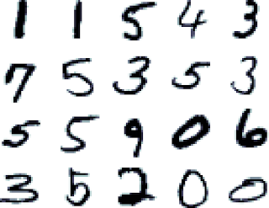
Deep Neural Network (DNN) Applications

Slide 6

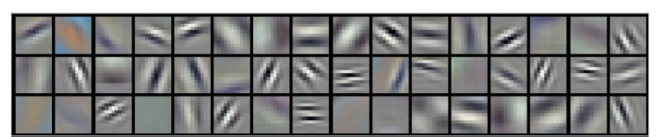
Convolutional Neural Network (CNN)
Convolutional Layers
(Feature Extraction)
Summarize features
Conv.
Layer
Conv.
Layer
Conv.
Layer
Pool.
Layer
FC
Layer
...
“House”
Massive
Parallelization Opportunity
Intermediate features

Slide 7
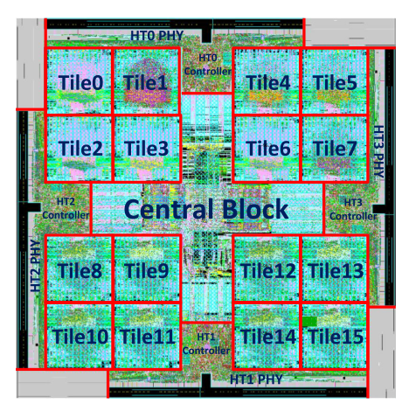
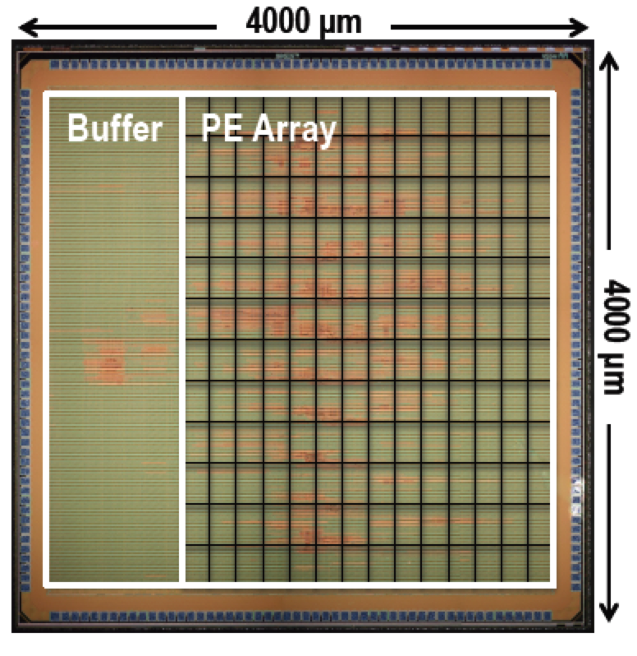


Accelerating DNN Computation
...
Dadiannao (2014)
Eyeriss (2016)
GPUs
Specialized ASICs
High Throughput
High Throughput
Flexibility
Energy Efficiency
Irregular Dataflow
Energy Efficiency
Inflexible Design

Slide 8
Sources of Irregular Dataflow
DNN Topologies
  Layer size / shape
  Layer types: Convolution / Pool / FC / LSTM
  New sub-structure: e.g., Inception in Googlenet
Dataflow Optimization
  Loop reordering
  Loop tiling
  Cross-layer mapping
Algorithmic Optimization
  Weight pruning: Sparse workload

Slide 9

Accelerators for Each Irregular Dataflow
Sparse CNN: SCNN (2017), EIE(2016), ...
Cross-layer: Fused CNN (2016)
Dataflow: FlexFlow (2017), Eyeriss (2016), ...
LSTM: ESE (2017), ...
...
Can we have one architectural solution to rule them all?
Identify common computation/communication patterns across all of them
Notes:
If we need one DNN acc in a chip -> we need something (LOTR meme)

Slide 10
Outline
Motivation
DNN Compute & Communication
MAERI Approach
MAERI Architecture
Evaluation
Conclusion

Slide 11
Background: Convolutional Layer in CNN
Compute weighted sum
Independent multiplication
Accumulation of multiplication results
Notes:
First show CNN sliding window figure

Slide 12
Regular Dataflow
Similar to dense matrix multiplication
Regular communication pattern between buffer and compute units
Notes:
First show CNN sliding window figure

Slide 13
Irregular Dataflow: Fused-Layer
Example: Cross-layer Mapping
For simplicity, folded over row
Irregular number of weight/input pairs for each neuron
* M. Alwani et al., Fused-Layer CNN Accelerators, MICRO 2016
For simplicity, folded over row

Slide 14
Irregular Dataflow: Pruning
Example: Weight Pruning (Sparse Workload)
Pruning
Irregular number of weight/input pairs for each neuron
Notes:
Removed edges -> color

Slide 15
Underutilization from Irregular Neuron Size
Example: Weight Pruning (Sparse Workload)
Key Insight: Rigid Interconnect does not allow efficient mapping of irregular dataflows

Slide 16

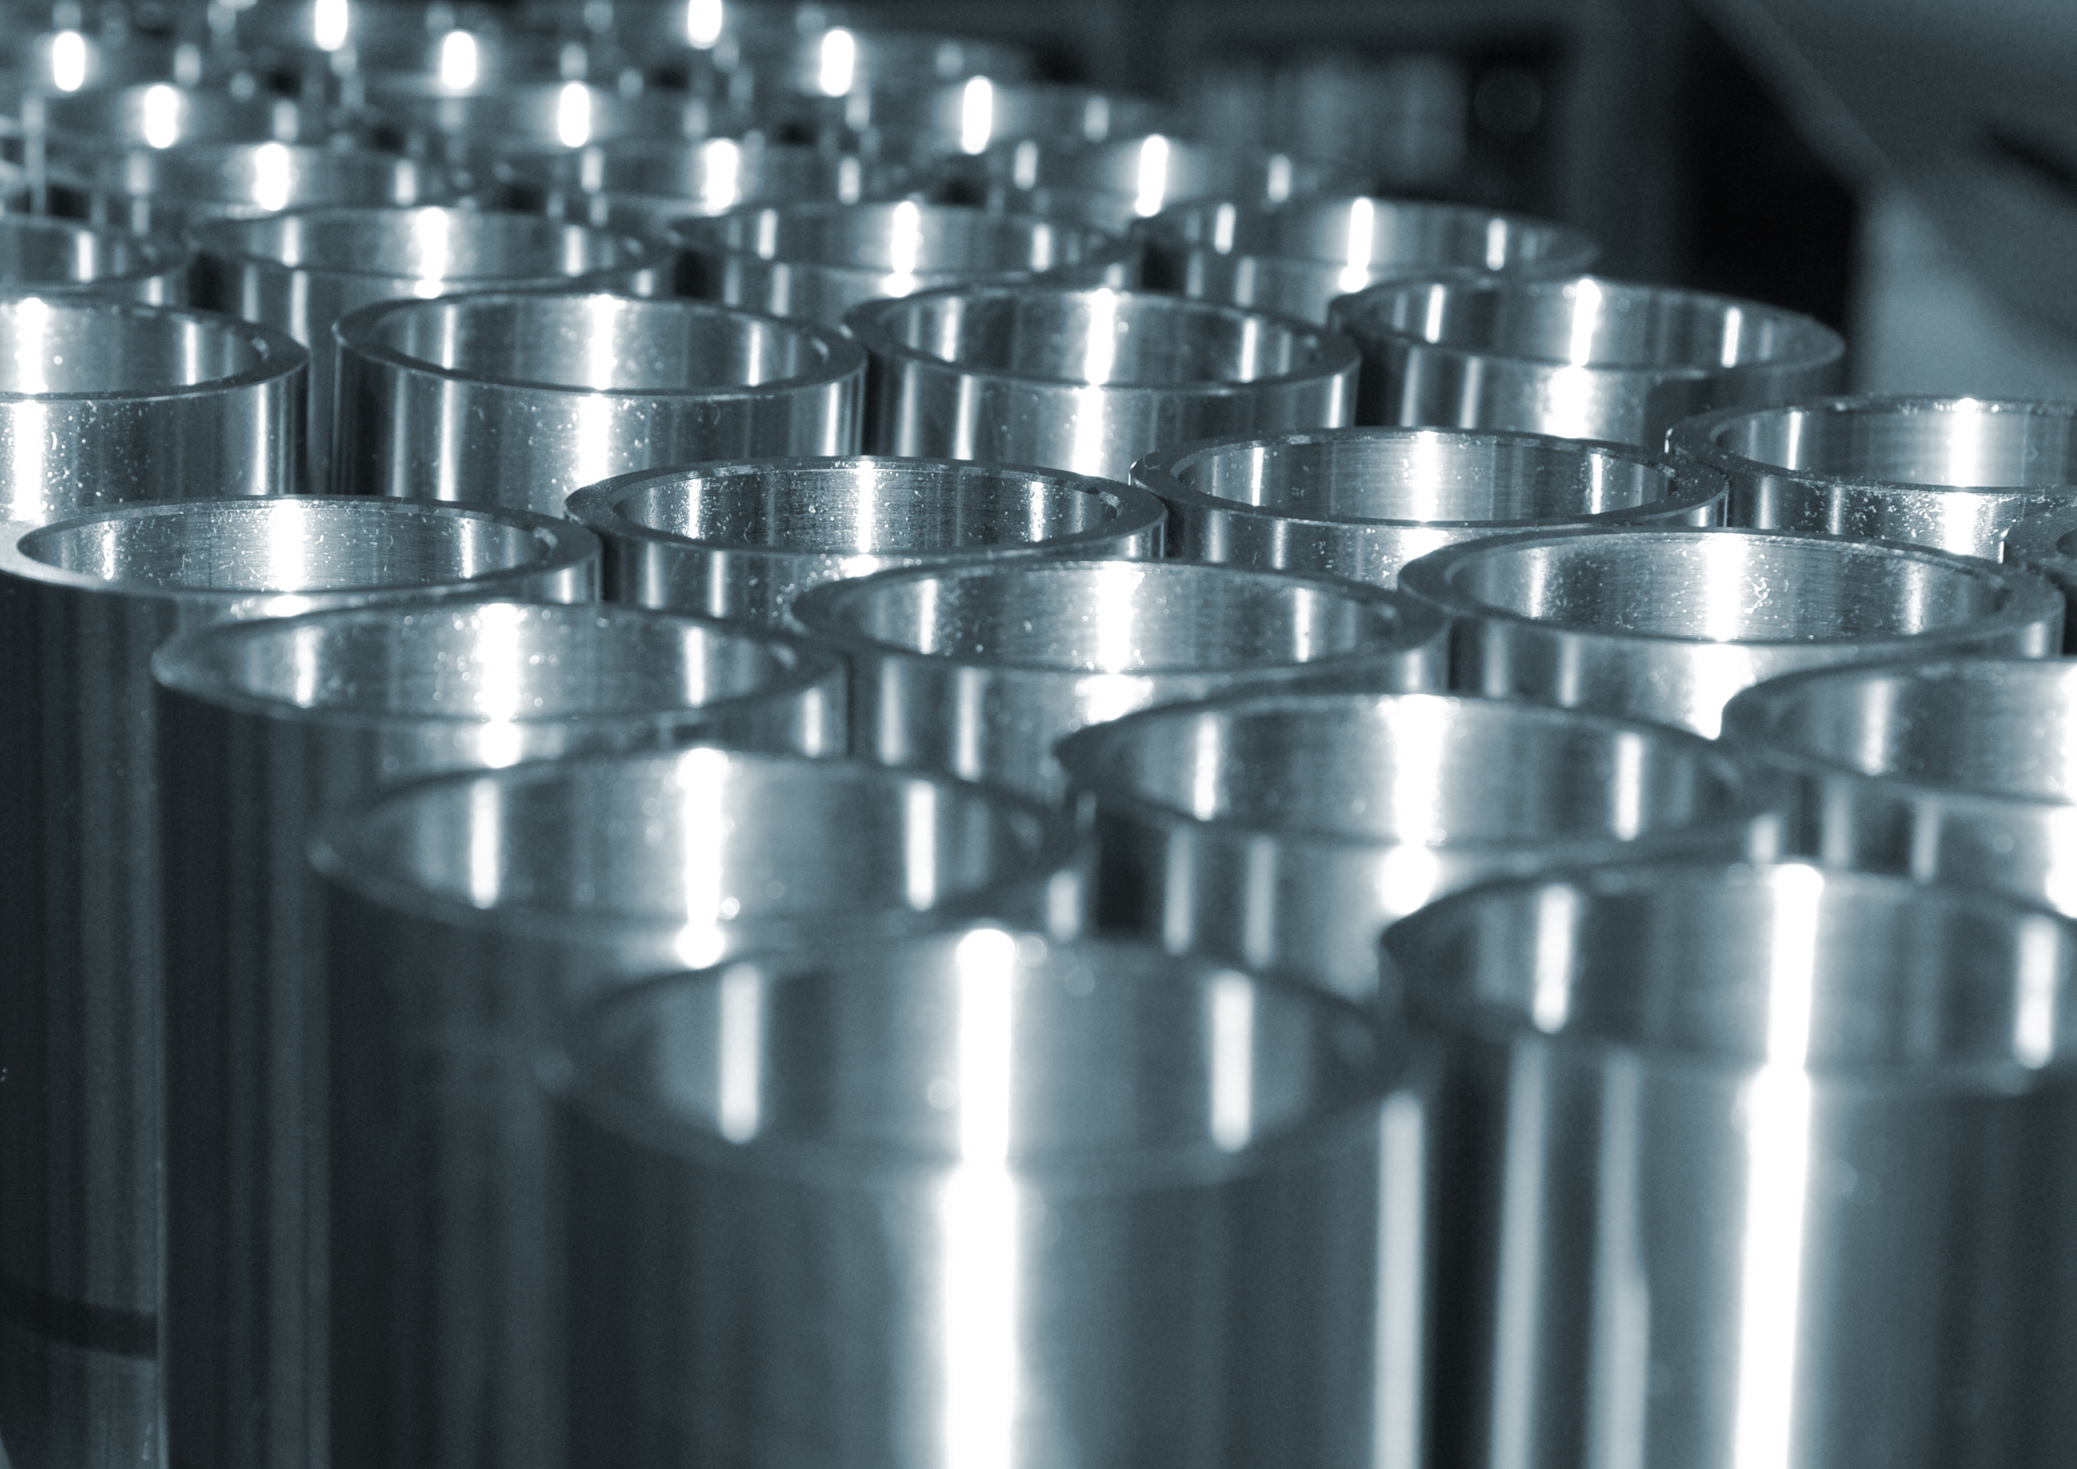
Take-aways
New optimizations
Irregular Neuron Size
Reconfigurable Interconnection
Compute Resource
High Utilization
Compute Resource
Underutilization
Rigid Interconnection in Accelerators

Slide 17
Outline
Motivation
DNN Compute & Communication
MAERI Approach
MAERI Architecture
Evaluation
Conclusion

Slide 18
Designing a Fully Flexible Accelerator
“MultAlloc(3); AddAlloc(2)”
NN figure showing 3 neurons highighted
MultiplierPool
VN0
VN1
VN2
Adder
Pool
How to enable flexible grouping?
Virtual Neuron (VN): Temporary grouping of compute units for an output (neuron)
Need to provide flexible connectivity among arbitrary compute units and buffer

Slide 19
Naïve Approach: Fully-connected Design
Need “specialization” in interconnection network
for traffic in DNN accelerators
Wire overhead = O(n²)

Slide 20
Traffic Patterns in DNN Accelerators*
PB
NoC
PE
PB
NoC
PE
PB
NoC
PE
PE
PE
PE
PE
PE
PE
PE
PE
PE
Distribution
Collection
Local Forwarding
e.g. weight distribution to PEs in weight-stationary accelerator
e.g. output collection in output-stationary accelerator
e.g. Input forwarding in row-stationary accelerator
* PB: Prefetch buffer (Global buffer)
* NoC: Network-on-Chip (Interconnection network)
* PE: Processing element (Compute units)
* H. Kwon et al., Rethinking NoCs for Spatial DNN Accelerators, NOCS 2017

Slide 21
Practical Approach: Minimal Switches
One port for distribution
One port for local forwarding
Using these minimal switches...
How do we design a specialized connectivity (topology) allowing flexible mapping?
Two ports for collection
Extra port for flexible mapping
3 x 2 switch
2 x 2 switch

Slide 22
Connectivity: Distribution of Weights/Inputs
Extra bandwidth
Features
Tree-based topology
  Supports multicasting for spatial data reuse
Extra bandwidth near the top
  Provides high bandwidth that enables multiple multicasting simultaneously

Slide 23
Connectivity: Collection of Outputs
Extra link
Augmented Reduction Tree (ART)
Features
Extra link
enabled
red VN
Extra links
  Supports non-blocking in-network reductions for arbitrary virtual neuron sizes
  Provides high compute unit utilization
Extra bandwidth near the root switch
  Provides high bandwidth that enables multiple reduction (accumulation) simultaneously
Extra bandwidth

Slide 24
Connectivity: Local Communication
Enables spatio-temporal date reuse

Slide 25
Outline
Motivation
DNN Compute & Communication
MAERI Approach
MAERI Architecture
Evaluation
Conclusion

Slide 26
Switch Microarchitecture
Light-weight structure

Slide 27
MAERI DNN Accelerator
(VN Construction)

Slide 28
MAERI DNN Accelerator: Features
Novel tree-based topology
  Provides near-non-blocking communication via reconfigurable links with high-bandwidth
  Support efficient irregular dataflow mapping
  Provides high utilization of compute units
Data reuse support
  Temporal: enabled via local buffers in mult. switches
  Spatial: enabled via multicasting in distribution tree
  Spatio-Temporal: enabled via forwarding links between multiplier switches

Slide 29
MAERI DNN Accelerator: Features
Regular/Irregular Dataflow Support
  Dense convolution
  Sparse convolution
  Fully-connected layer
  LSTM
  Cross-layer fusion
  ...
Details in paper!

Slide 30
Outline
Motivation
DNN Compute & Communication
MAERI Approach
MAERI Architecture
Evaluation
Conclusion

Slide 31
Evaluation
Performance
  Dense workload: Convolution layer
  Irregular workload: Cross-layer workload
Impact of Interconnect
  Variable virtual neuron size
Overhead
  Area/power overhead (post-synthesis)

Slide 32
Performance with Dense Workload
Baseline
8x8 Systolic Array
64-PE Row-stationary Accelerator
TPU-Style
Eyeriss-Style

Slide 33
Performance with Dense Workload
Total Latency (Runtime)
Foldings due to Large filter size(11x11, 5x5)
* Normalized to ideal case (100% utilization, Infinite bandwidth)
In average, MAERI reduces runtime upto 65%, 42% in avg.
Notes:
Compiler Opitimzation

Slide 34
Evaluation
Performance
  Dense workload: Convolution layer
  Irregular workload: Cross-layer workload
Impact of the Interconnect
  Variable virtual neuron size
Overhead
  Area/power overhead (post-synthesis)

Slide 35
Performance with Cross-layer Workload
Baseline
SCNN* Style, 64PEs
* A. Parashar et al., SCNN: An Accelerator for Compressed-sparse Convolutional Neural Networks, ISCA 2017

Slide 36
Performance with Cross-layer Workload
Speed-up and Utilization
Fused Alexnet
MapA: C1+C2+C3
MapB: C2+C3+C4
MapC: C3+C4+C5
MapD: C1+C2+C3+C4
MapE: C2+C3+C4+C5
8-33% better utilization
23% speed-up in average

Slide 37
Evaluation
Performance
  Dense workload: Convolution layer
  Irregular workload: Inter-layer workload
Impact of Interconnect
  Variable virtual neuron size
Overhead
  Area/power overhead (post-synthesis)

Slide 38
Utilization with Various VN Size
Baseline
Base Tree Size = 16 (Increase tree size by 2 when mapped VN size is larger than current size)

Slide 39
Utilization with Various VN Size
Workload: VGG-16 CONV6
Augmented links
ART in MAERI
Wide links
249% better utilization in average

Slide 40
Evaluation
Performance
  Dense workload: Convolution layer
  Irregular workload: Inter-layer workload
Impact of Interconnect
  Variable virtual neuron size
Overhead
  Area/energy overhead (post-synthesis)

Slide 41
Overhead Evaluation Environment
Technology: Synopsys 28nm
Implementation: Bluespec System Verilog
Designs
  Row-stationary (Eyeriss style)
  Systolic array (TPU style)
  MAERI
Comparison Method: Compute match
  All the designs have the same number of PEs as Eyeriss (168 PEs)

Slide 42
Overhead: Area
* With 168 PEs, post-synthesis number
Fully-addressable scratchpad
Cost of
reconfigurability
With the same area as row-stationary, MAERI houses 2.33X more compute units

Slide 43
Energy with Convolution Layers
* Normalized to MAERI energy with Alexnet C1
MAERI reduces energy upto 57% and 28% in average compared to Row-Stationary (dense dataflow) and 7.1% in average compared to Systolic Array (sparse dataflow)

Slide 44
Outline
Motivation
DNN Compute & Communication
MAERI Approach
MAERI Architecture
Evaluation
Conclusion

Slide 45
Conclusion
Diverse DNN dimensions and optimizations (sparsity, fused layer, etc.) introduce irregular dataflow in DNN accelerators
Most of DNN accelerators contain rigid interconnections that lead to under-utilization with irregular dataflow
MAERI provides reconfigurable non-blocking interconnect between compute units and sufficient bandwidth to support both regular and irregular dataflow
MAERI provided 8-458% better compute unit utilization across multiple dataflow mappings that results in 72.4% lower latency in average

Slide 46
Announcement
Tutorial in ISCA 2018
Half-day tutorial on June 3 (morning)
T10: An Open Source Framework for Generating Modular DNN Accelerators supporting Flexible Dataflow
(http://synergy.ece.gatech.edu/tools/maeri/maeri_tutorial_isca2018/)
          Formal Dataflow analysis methodology
          MAERI RTL Release
          Deep-dive and Examples
Thank you!

