Slide 1

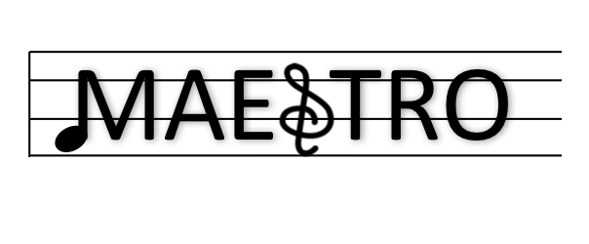
MAERI: Enabling Rapid Design Space Exploration and Prototyping of DNN Accelerators
Hyoukjun Kwon
Michael Pellauer
Tushar Krishna
http://synergy.ece.gatech.edu/tools/maeri/maeri_tutorial_isca2018/
ISCA Tutorial June 3, 2018

Slide 2
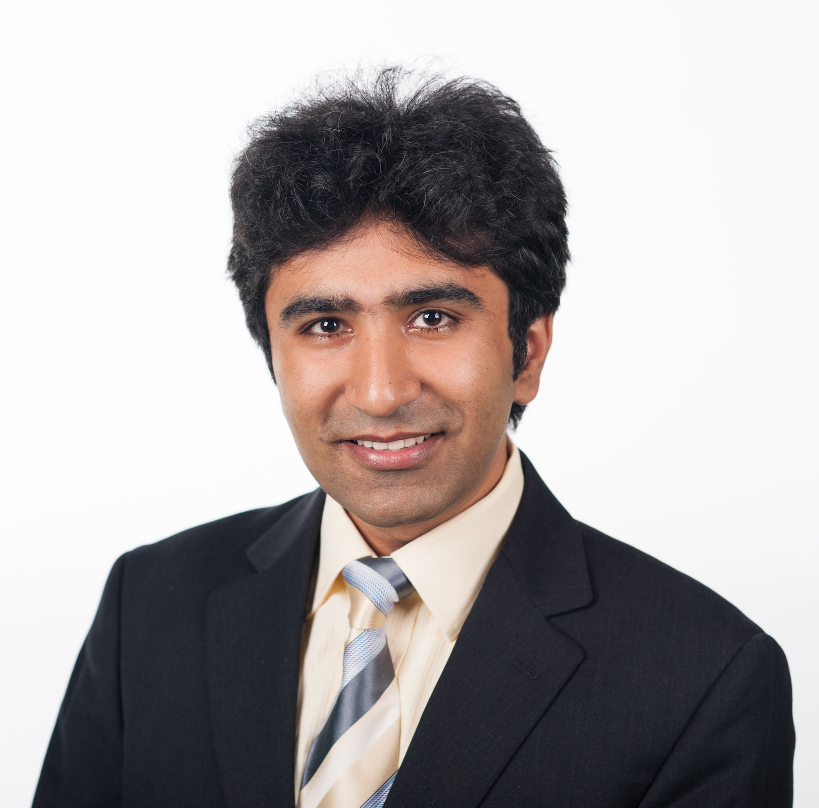

Presenters
  Tushar Krishna
  Assistant Professor, School of ECE,
  Georgia Tech
  PhD (MIT) in 2014
  tushar@ece.gatech.edu
  Michael Pellauer
  Sr. Research Scientist,
  NVIDIA
  Intel VSSAD (2010-2015)
  PhD (MIT) in 2010
  mpellauer@nvidia.com
  Hyoukjun Kwon
  PhD Candidate
  School of CS,
  Georgia Tech
  hyoukjun@gatech.edu

Slide 3
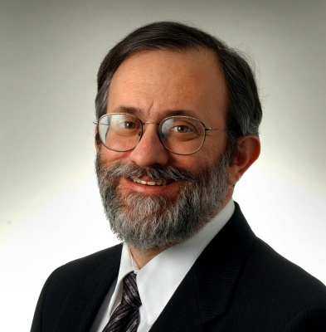

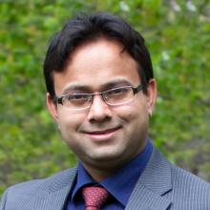

Acknowledgments
Joel Emer
Sr. Distinguished Research Scientist
NVIDIA
Professor
MIT
Vivienne Sze
Associate Professor
MIT
  Angshuman Parashar
  Sr. Research Scientist,
  NVIDIA
  Yu-Hsin Chen
  PhD Candidate
  MIT
  Ananda Samajdar
  PhD Candidate
  Georgia Tech

Slide 4
Schedule
Time | Topic | Presenter
8:30 to 8:45 | Introduction and Background | Tushar
8:50 to 10:00 | MAESTRO: A performance and cost model for DNN dataflows – What are dataflows and why they matter - MAESTRO pragmas and DSL to describe dataflows | Michael
9:40 – 10:00 | MAESTRO hands-on exercises | Michael
10:00 – 10:30 | Coffee Break (+ continued hands-on exercises)
10:30- 11:15 | MAERI: An Open Source RTL for Flexible DNN Accelerators - Microarchitecture Overview - Code Overview | Hyoukjun
11:15 – 11:45 | MAERI hands-on exercises | Hyoukjun
11:45 – 12:00 | Wrap-up and Future Extensions | Tushar

Slide 5
Outline
What this tutorial is about
  Role within the Deep Learning landscape
  Difference from Tutorial by Joel and Vivienne
Software setup
  VM for running MAESTRO and MAERI on your laptops
Relevant Background
  Deep Neural Networks
  Why DNN Accelerators

Slide 6
What this tutorial is about

Slide 7
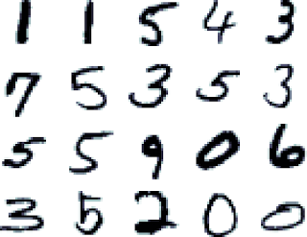
Deep Learning Applications

Slide 8



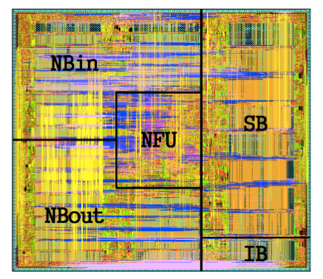
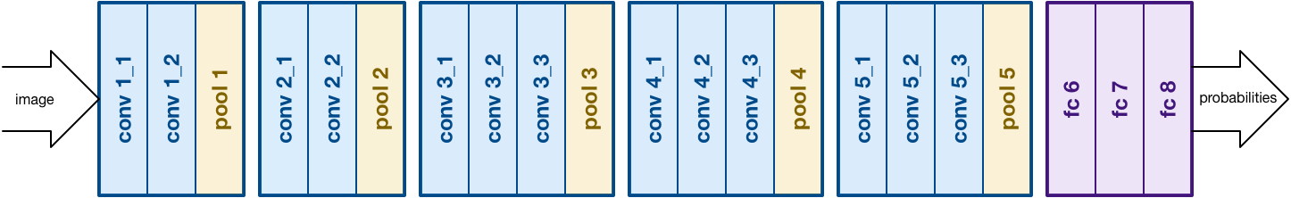
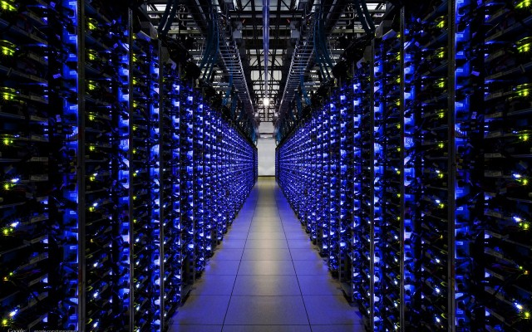
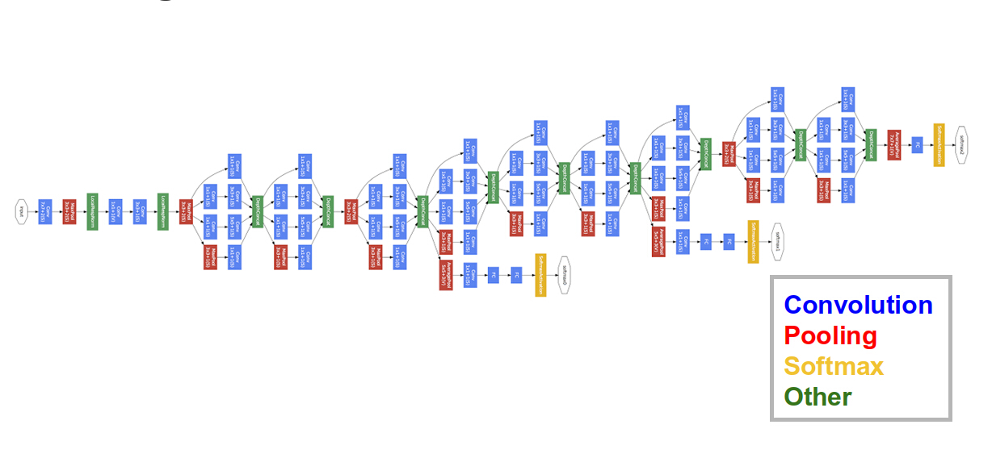

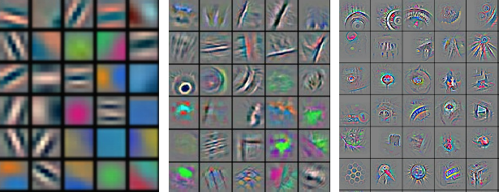





Deep Learning Landscape
Apple Neural Engine
ShiDIanNao
NVDLA
ARM Trillum
Eyeriss
CambriconX
Model Creation
Training
Inference
TensorRT
MLSL
Design Tools
This Tutorial

Slide 9
Sister Tutorial
“Hardware Architectures for Deep Neural Networks”
  By Joel Emer, Vivienne Sze and Yu-Hsin Chen
  ISCA 2017, MICRO 2016, …
  Outline
    Overview of Deep Neural Networks
    Survey of Recent DNN Models
    Survey of Recent DNN Accelerators
    DNN and Hardware Co-Design
    Benchmarking Metrics
The focus of this tutorial is on practical tools to enable DNN accelerator architecture design-space exploration, mapping strategies, and hardware prototyping

Slide 10
Software Setup

Slide 11
Logistics and Software Setup
WiFi Information
  Username: ISCA2018
  Password: Turing2018
VM with MAESTRO and MAERI code
  We passing around pen-drives
  Copy the .vbox and .vdi files into the same directory
  If you have Virtual Box installed, then you can directly copy and launch VM
    Else VirtualBox installation files are also on the pen-drive
    Password for VM: maeri2018
Please sign the sign-up sheet being passed around

Slide 12
Relevant Background

Slide 13
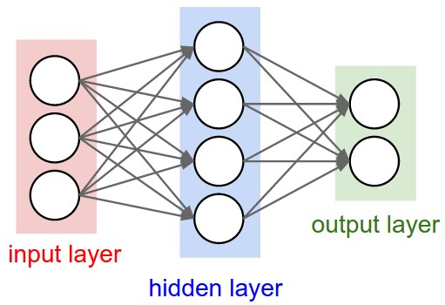
What is a Deep Neural Network?
Neurons
Synapses
W₁₁
Y₁
X₁
Y₂
X₂
Weighted Sum
Y₃
X₃
W₃₄
Y₄
Each synapse has a weight for neuron activation
[Image Source: Stanford]

Slide 14
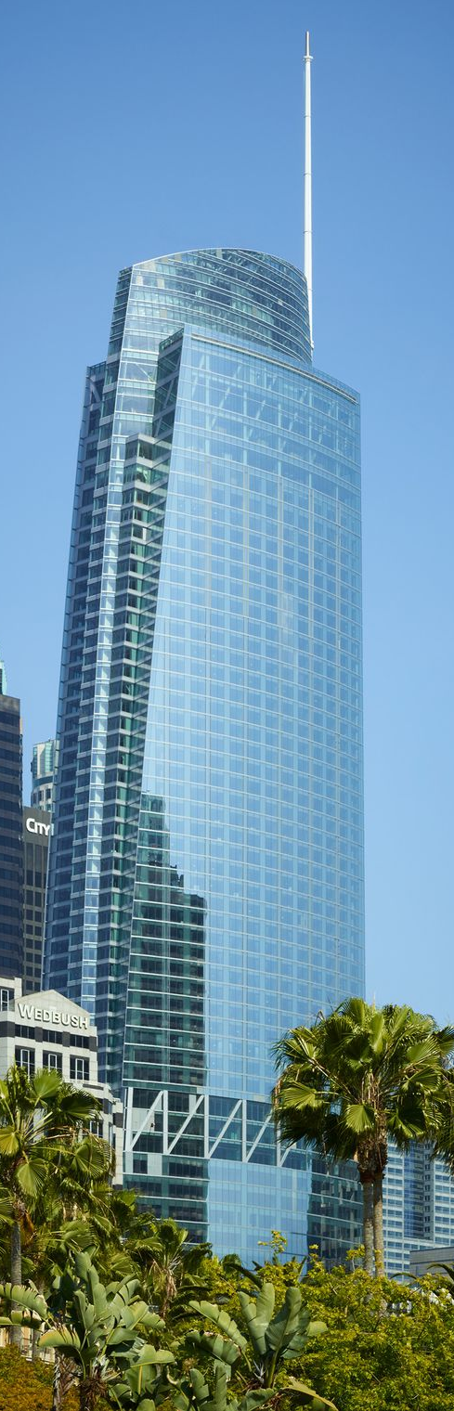
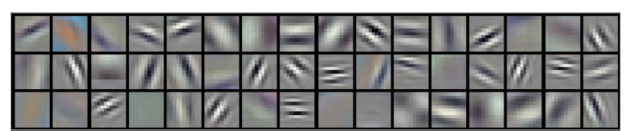
Modern Deep Learning Landscape
Model Creation
Training
Inference
Convolutional Layers
(Feature Extraction)
Summarize features
Conv.
Layer
Conv.
Layer
Conv.
Layer
Pool.
Layer
FC
Layer
...
“Intercontinental Hotel”
Intermediate features

Slide 15
Why do we need DNN accelerators?
Millions of Parameters (i.e., weights)
  Millions of computations
  Heavy data movement
Need lots of parallel compute
DNN Topology | Number of Weights
AlexNet (2012) | 3.98M
VGGnet-16 (2014) | 28.25M
GoogleNet (2015) | 6.77M
Resnet-20 (2016) | 0.27M
Resnet-110 (2016) | 1.7M
Need to reduce energy

Slide 16
Spatial (or Dataflow) Accelerators
Millions of Parameters (i.e., weights)
  Millions of computations
  Heavy data movement
Memory Hierarchy
Spread computations across hundreds of ALUs
ALU
ALU
ALU
ALU
Control
Register/FIFO/SRAM
ALU
ALU
ALU
ALU
Memory Hierarchy
ALU
ALU
ALU
ALU
Reuse data within the array via direct communication
ALU
ALU
ALU
ALU
Examples: MIT Eyeriss, Google TPU, …

Slide 17
Two Key HW Design Challenges
How do we map millions of computations over limited compute and memory resources (aka Dataflow)?
How do we design the accelerator to efficiently map arbitrary layer types and dataflows?

Slide 18
MAESTRO: A performance and cost model for DNN dataflows
https://arxiv.org/abs/1805.02566

Slide 19
MAERI – An Open Source RTL for Flexible DNN Accelerators
BSV Compiler
Kwon et al., ASPLOS 2018

Slide 20
Welcome to the Tutorial!

Slide 21
Schedule
Time | Topic | Presenter
8:30 to 8:45 | Introduction and Background | Tushar
8:50 to 10:00 | MAESTRO: A performance and cost model for DNN dataflows – What are dataflows and why they matter - MAESTRO pragmas and DSL to describe dataflows | Michael
9:40 – 10:00 | MAESTRO hands-on exercises | Michael
10:00 – 10:30 | Coffee Break (+ continued hands-on exercises)
10:30- 11:15 | MAERI – An Open Source RTL for Flexible DNN Accelerators - Microarchitecture Overview - Code Overview | Hyoukjun
11:15 – 11:45 | MAERI hands-on exercises | Hyoukjun
11:45 – 12:00 | Wrap-up and Future Extensions | Tushar

Slide 22
Backup

Slide 23
How to map convolution over array?
for(n=0; n<N; n++) { // Input feature maps (IFMaps)
for(m=0; m<M; m++) { // Weight Filters
for(c=0; c<C; c++) { // IFMap/Weight Channels
for(y=0; y<H; y++) { // Input feature map row
for(x=0; x<H; x++) { // Input feature map column
for(j=0; j<R; j++) { // Weight filter row
for(i=0; i<R; i++) { // Weight filter column
O[n][m][x][y] += W[m][c][i][j] * I[n][c][y+i][x+j]}}}}}}}
Memory Hierarchy
ALU
ALU
ALU
ALU
ALU
ALU
ALU
ALU
Memory Hierarchy
ALU
ALU
ALU
ALU
How do we map millions of computations over limited compute and memory resources?
ALU
ALU
ALU
ALU
  Loop Ordering
  Loop Unrolling
  Loop Tiling
  Spatial Mapping
  Temporal Mapping
“Dataflow”
Why does the dataflow matter?

Slide 24
Dataflow → Traffic Flow
Dataflow determines data movement direction and bandwidth (amount and rate)

Slide 25
Dataflow → Energy
Dataflow List
NLR: No-local-reuse
WS: Weight-stationary
Shi: Shi-Diannao
RS: Row Stationary (Eyeriss)
DLA: NVIDIA DLA
Dataflow determines energy consumption at various levels of memory hierarchy
More details:
https://arxiv.org/abs/1805.02566

Slide 26
Dataflow → Utilization
X
X
X
X
0
0
X
X
X
X
X
X
X
0
Layer Dimensions
Layer Type
(e.g., LSTM/FC)
Sparsity
Dataflow determines compute unit utilization

