Slide 1

MAERI: An Open-source Framework for Generating DNN Accelerators with Flexible Dataflow Support
Hyoukjun Kwon*, Michael Pellauer**, and Tushar Krishna*
*Synergy Lab, Georgia Institute of Technology
** Architecture Research Group, NVIDIA
ISCA 2018
June 3, 2018

Slide 2
Acknowledgement
(in particular for this session)
Mr. Charlie Hauck
Dr. Rishiyur Nikhil
Ananda Samajdar
Eric Qin
Yehowshua Immanuel
For providing BSV license for hands-on exercises
For ASIC and FPGA synthesis/PnR

Slide 3
Outline
Tool Flow of MAERI
Design
Architecture
Source code and MAERI front-end
Demo
Hands-on Exercises

Slide 4
Tool Flow of MAERI

Slide 5
Bluespec System Verilog (BSV)
A high-level hardware description language
  Generates fully synthesizable Verilog
Inspired by Haskell and System Verilog
  Strong type-checking system and polymorphism
  System Verilog-like syntax
  Intuitive module interfaces
Based on “guarded atomic action” blocks
  Provides coarse-grained description of parallel actions
For details, please refer to “BSV by Example” (http://csg.csail.mit.edu/6.S078/6_S078_2012_www/resources/bsv_by_example.pdf)

Slide 6
Outline
Tool Flow of MAERI
Design
Architecture
Source code and MAERI front-end
Demo
Hands-on Exercises

Slide 7
Background: Convolutional Layer in CNN
Compute weighted sum
Independent multiplication
Accumulation of multiplication results
Notes:
First show CNN sliding window figure

Slide 8
Fully Flexible Accelerator
“MultAlloc(3); AddAlloc(2)”
MultiplierPool
VN0
VN1
VN2
Adder
Pool
How to enable flexible grouping?
Virtual Neuron (VN): Temporary grouping of compute units for an output (neuron)
Need to provide flexible connectivity among arbitrary compute units and buffer

Slide 9
Practical Approach: Minimal Switches
One port for distribution
One port for local forwarding
Using these minimal switches...
How do we design a specialized connectivity (topology) allowing flexible mapping?
Two ports for collection
Extra port for flexible mapping
3 x 2 switch
2 x 2 switch

Slide 10
Connectivity: Distribution of Weights/Inputs
Extra bandwidth
Features
Fat tree-based topology
  Supports multicasting for spatial data reuse
Extra bandwidth near the top
  Provides high bandwidth that enables multiple multicasting simultaneously

Slide 11
Connectivity: Local Communication
Enables spatio-temporal date reuse

Slide 12
Connectivity: Reduction/Collection of Outputs
Extra link
Augmented Reduction Tree (ART)
Features
Extra link
enabled
red VN
Extra links
  Supports non-blocking in-network reductions for arbitrary virtual neuron sizes
  Provides high compute unit utilization
Extra bandwidth near the root switch
  Provides high bandwidth that enables multiple reduction (accumulation) simultaneously
Extra bandwidth

Slide 13
Outline
Tool Flow of MAERI
Design
Architecture
Source code and MAERI front-end
Demo
Hands-on Exercises

Slide 14
Switch Microarchitecture
Light-weighted structure

Slide 15
MAERI DNN Accelerator
(VN Construction)

Slide 16
Regular and Irregular Dataflow
DNN Topologies
  Layer size / shape
  Layer types: Convolution / Pool / FC / LSTM
  New sub-structure: e.g., Inception in Googlenet
Compiler Optimization
  Loop reordering
  Loop tiling size
  Cross-layer mapping
Algorithmic Optimization
  Weight pruning: Sparse workload
Our Key insight: Each dataflow translates into neurons of different sizes

Slide 17
Dense Dataflow

Slide 18
Irregular Dataflow Support Example
Sparse Convolutional Layer

Slide 19
Irregular Dataflow Support Example
Fully-connected / LSTM layer
Details in paper!
* H. Kwon et al., “MAERI: Enabling Flexible Dataflow Mapping over DNN Accelerators via Reconfigurable Interconnects,” ASPLOS 2018

Slide 20
Outline
Tool Flow of MAERI
Design
Architecture
Source code and MAERI front-end
Demo
Hands-on Exercises

Slide 21
Source code directory structure
maeri_code_isca2018_tutorial
scripts
src
types
Internal BSV type definitions
lib
Custom libraries
ART
Augmented reduction tree
distribution_network
Distribution tree
multiplier_switch
Multiplier switch and its array
fixedPointUnits
Fixed point adder/multiplier
testbench
Testbenches
MAERI core implementation

Slide 22
How to use MAERI front-end
Configuration change
  Modify AcceleratorConfig.bsv at the top directory
    Distribution bandwidth
    Reduction bandwidth
    Number of multiplier switches
Verilog code generation and simulation
  ./Maeri –c : Compile a simulation
  ./Maeri –r : Run compiled simulation
  ./Maeri –w : Launch GTKwave for waveform analysis
  ./Maeri –v : Generate Verilog code
  ./Maeri –clean : Clean up intermediate files

Slide 23
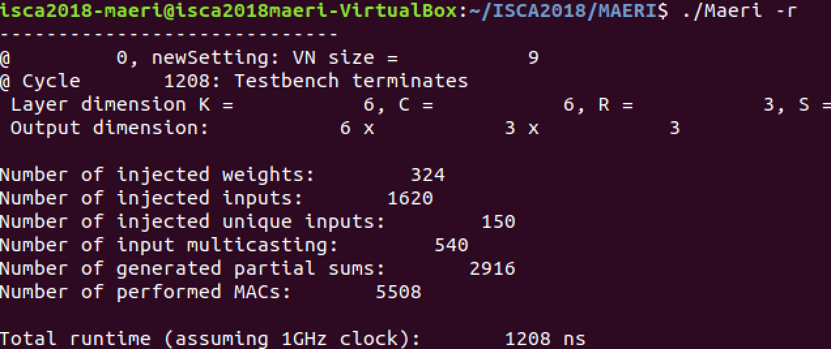
How to use MAERI front-end
Simulation results example
  Triggered with “./Maeri –r” after “./Maeri –c”

Slide 24
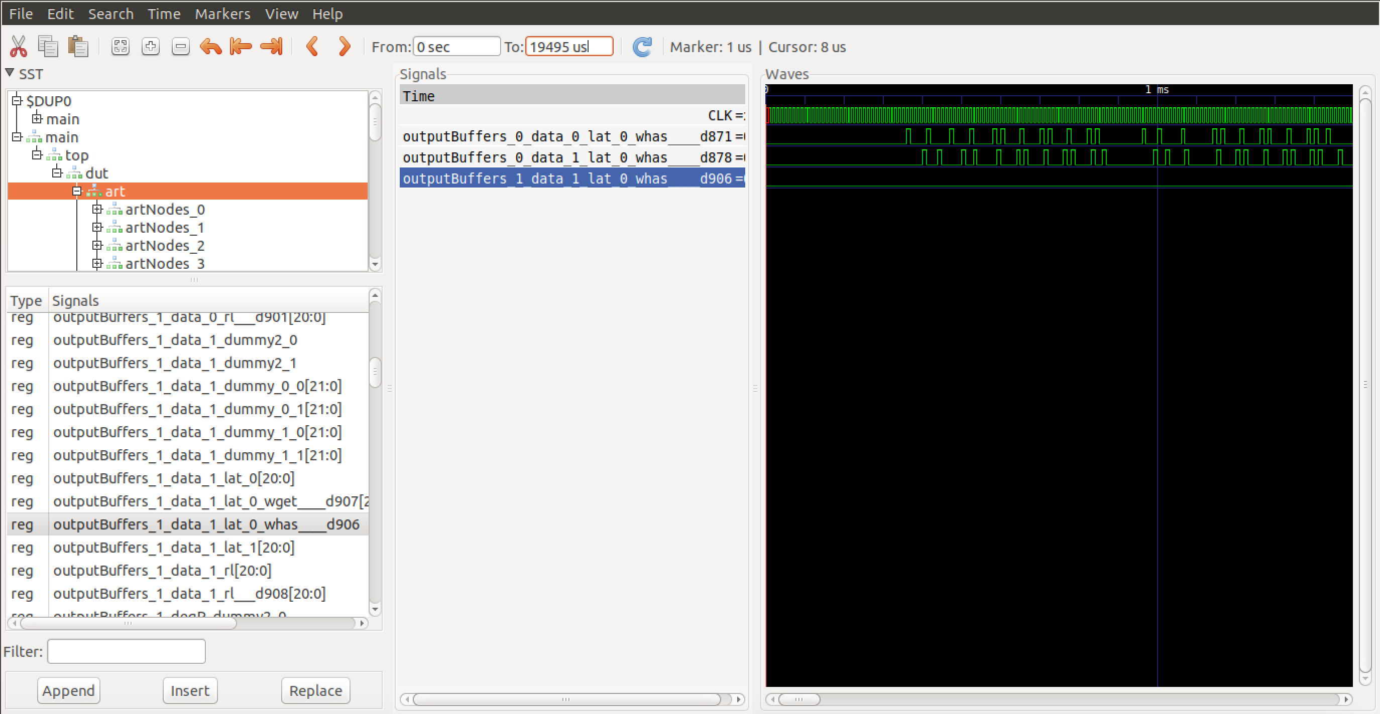
How to use MAERI front-end
Waveform Analysis
  Triggered with “./Maeri –w” after “./Maeri –r”

Slide 25
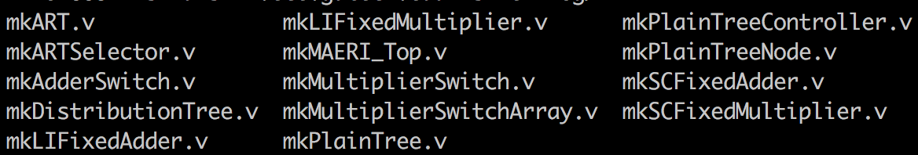
How to use MAERI front-end
Verilog generation example
  Triggered with “./Maeri –v”
* Verilog files are generated in “(Top_Directory)/Verilog”
Generated Verilog code is synthesizable!

Slide 26
MAERI Synthesis/PnR
Synthesis/PnR Environment
  Technology: TSMC 28nm
  Clock frequency: 1GHz
  Design: 64 multiplier switches and 31 adder switches
  Distribution Bandwidth: 16/4/1 data per cycle
  Gather Bandwidth: 16/4/1 data per cycle
  RTL Code: Verilog generated using MAERI code base
  CAD Tool Chain: Synopsys Design compiler, Cadence Innovus, Primepower

Slide 27
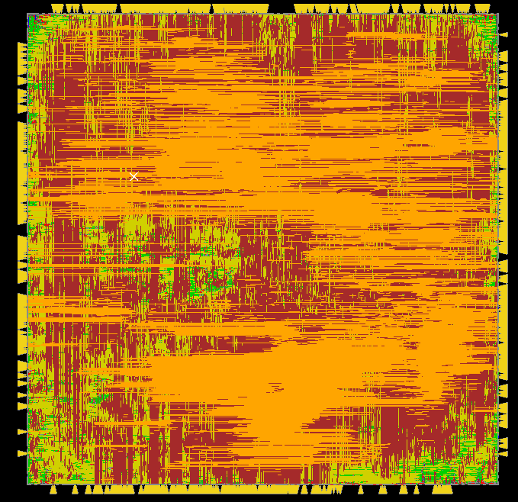
Post-layout Area and Power
Number of PEs | Distribution BW | Reduction BW | Area (mm²) | Power (mW)
64 | 16X | 4X | 0.440 | 407.861
64 | 4X | 16X | 0.255 | 252.326
64 | 4X | 1X | 0.219 | 194.912
64 | 1X | 4X | 0.239 | 254.603
* Based on 28nm technology and 1GHz clock

Slide 28
Outline
Tool Flow of MAERI
Design
Architecture
Source code Structure
Using MAERI source code base
Demo
Hands-on Exercises

Slide 29
Demo
Launching cycle-accurate simulations
Modifying user configuration
Compiling simulations
Launching wave form analysis
Generating Verilog files

Slide 30
Outline
Tool Flow of MAERI
Design
Architecture
Source code Structure
Using MAERI source code base
Demo
Hands-on Exercises

Slide 31
Revisiting Convention
K/C: Output/Input Channel
Y/X: Input activation height/width
R/S: Weight filter height/width

Slide 32
Testbench Structure

Slide 33
Testbench Dataflow (MAESTRO description)
  let sWindowSz = sizof(R) x sizeof(S)
  let numVNs = floor(NumMultSwitches / sWindowSz)
  Temporal_Map (1, 1) C
  Spatial_Map (1, 1) K
  Temporal_Map (1, 1) Y
  Temporal_Map(sWindowSz, 1) X
  Tile(sWindowSz)
  Unroll R
  Unroll S
High weight filter parallelism

Slide 34
Exercise#1: Compile a simulation with default, early, and late layers with 32 PEs (“./Maeri –c,” “-/Maeri –ctarg EARLY_SYNTHETIC,” “./Maeri –ctarg LATE_SYNTHETIC”). Run simulation and compare results.
Exercise#2: Compile a simulation with 32 and 64 PEs using default seting (“./Maeri –c”). Run simulation and compare results
Exercise#3: Compile a simulation with 2X/4X/and 8X distribution bandwidth (fix reduction bandwidth as 4X). Run simulation and compare results.
Exercise#4: Compile a simulation with 2X/4X/and 8X reduction bandwidth (fix distribution bandwidth as 4X). Run simulation and compare results.
Notes:
Simple exercises
1 Vary layers
2. Vary number of PEs (32/64)
3. NoC dist Bandwidth
4. NoC reduction Bandwidth

