Slide 1


MAERI: Enabling Rapid Design Space Exploration and Prototyping of DNN Accelerators
Hyoukjun Kwon
Michael Pellauer
Tushar Krishna
http://synergy.ece.gatech.edu/tools/maeri/maeri_tutorial_isca2018/
ISCA Tutorial June 3, 2018

Slide 2
Schedule
Time | Topic | Presenter
8:30 to 8:45 | Introduction and Background | Tushar
8:50 to 10:00 | MAESTRO: A performance and cost model for DNN dataflows – What are dataflows and why they matter - MAESTRO pragmas and DSL to describe dataflows | Michael
9:40 – 10:00 | MAESTRO hands-on exercises | Michael
10:00 – 10:30 | Coffee Break (+ continued hands-on exercises)
10:30- 11:15 | MAERI – An Open Source RTL for Flexible DNN Accelerators - Microarchitecture Overview - Code Overview | Hyoukjun
11:15 – 11:45 | MAERI hands-on exercises | Hyoukjun
11:45 – 12:00 | Wrap-up and Future Extensions | Tushar

Slide 3



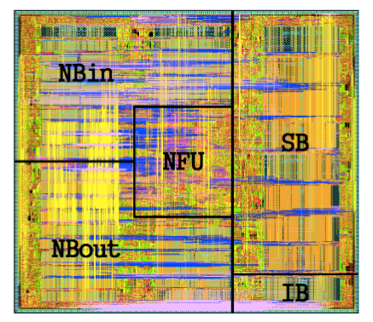
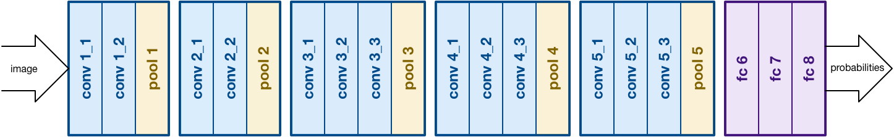
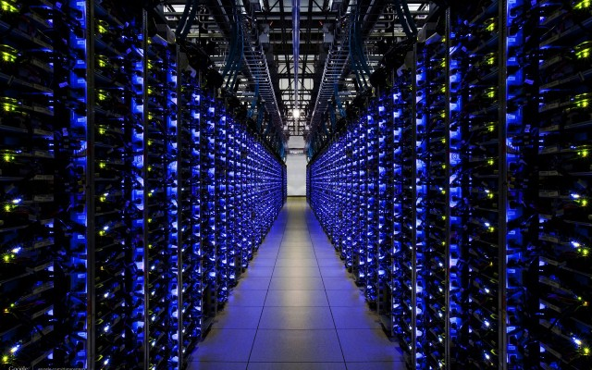
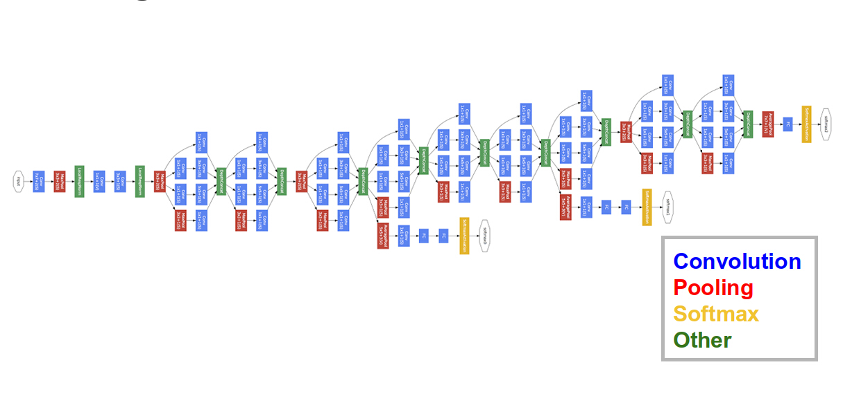

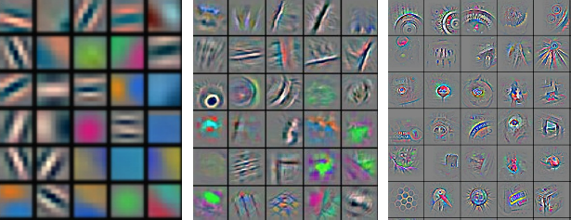



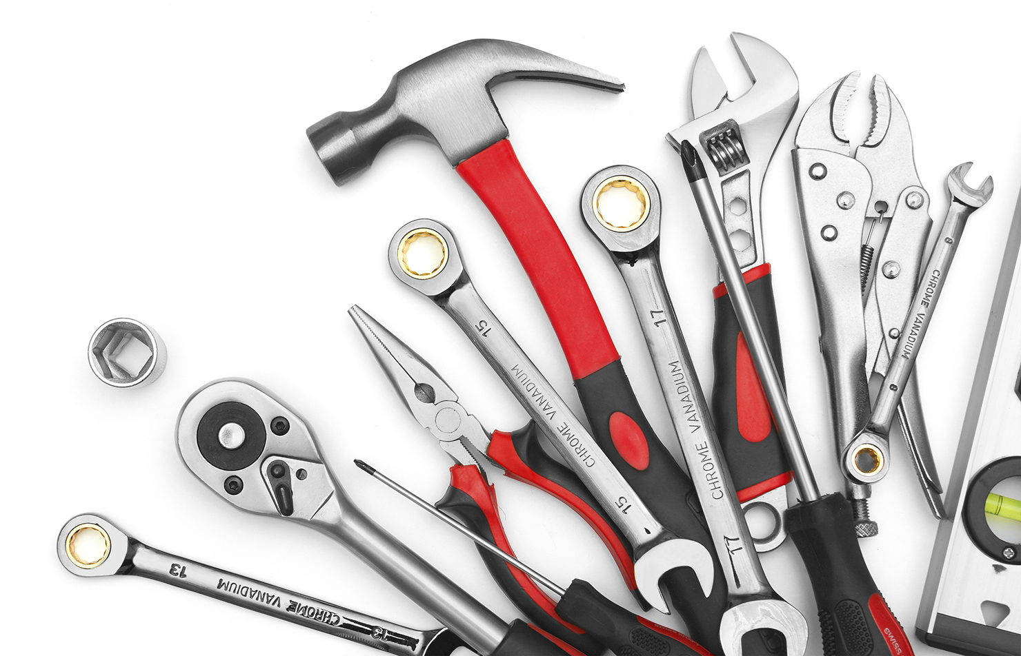
Deep Learning Landscape
Apple Neural Engine
ShiDIanNao
NVDLA
ARM Trillum
Eyeriss
CambriconX
Model Creation
Training
Inference
TensorRT
MLSL
Design Tools
This Tutorial

Slide 4
MAESTRO: A performance and cost model for DNN dataflows
https://arxiv.org/abs/1805.02566

Slide 5
MAERI – An Open Source RTL for Flexible DNN Accelerators
BSV Compiler
Kwon et al., ASPLOS 2018

Slide 6
Tool Release and Resources
  Sign-up at http://synergy.ece.gatech.edu/tools/maeri/maeri_tutorial_isca2018/ to receive updates on both MAESTRO and MAERI
Slides and Video will be posted on the tutorial page
  Feedback - we will send out a Survey on the tutorial and the tools
MAESTRO binary is ready to download and use
  validation is on-going – we will release the source-code after that
    we will send out an email once it is ready to all attendees
MAERI source code is ready to download and use
  The bluespec license in your VM will expire after this tutorial
    request a free university license from www.bluespec.com
  Verilog code for a few configurations distributed as part of release

Slide 7
Future Extensions
MAESTRO
  validation
  support for sparsity
  support for other layer-types
MAERI
  Testbenches for other layer-types and networks
  Automatic switch configuration generator
  Code-optimization for FPGAs

Slide 8
MAERI: Enabling Rapid Design Space Exploration and Prototyping of DNN Accelerators
Hyoukjun Kwon
Michael Pellauer
Tushar Krishna
Thank you!
http://synergy.ece.gatech.edu/tools/maeri/maeri_tutorial_isca2018/
ISCA Tutorial June 3, 2018

